Slide 2
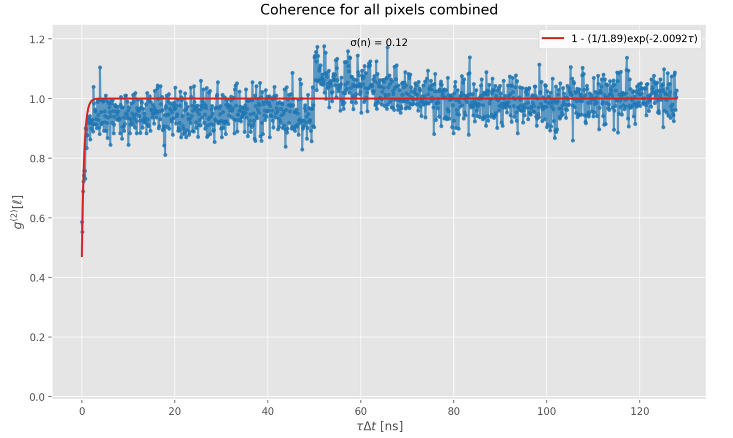
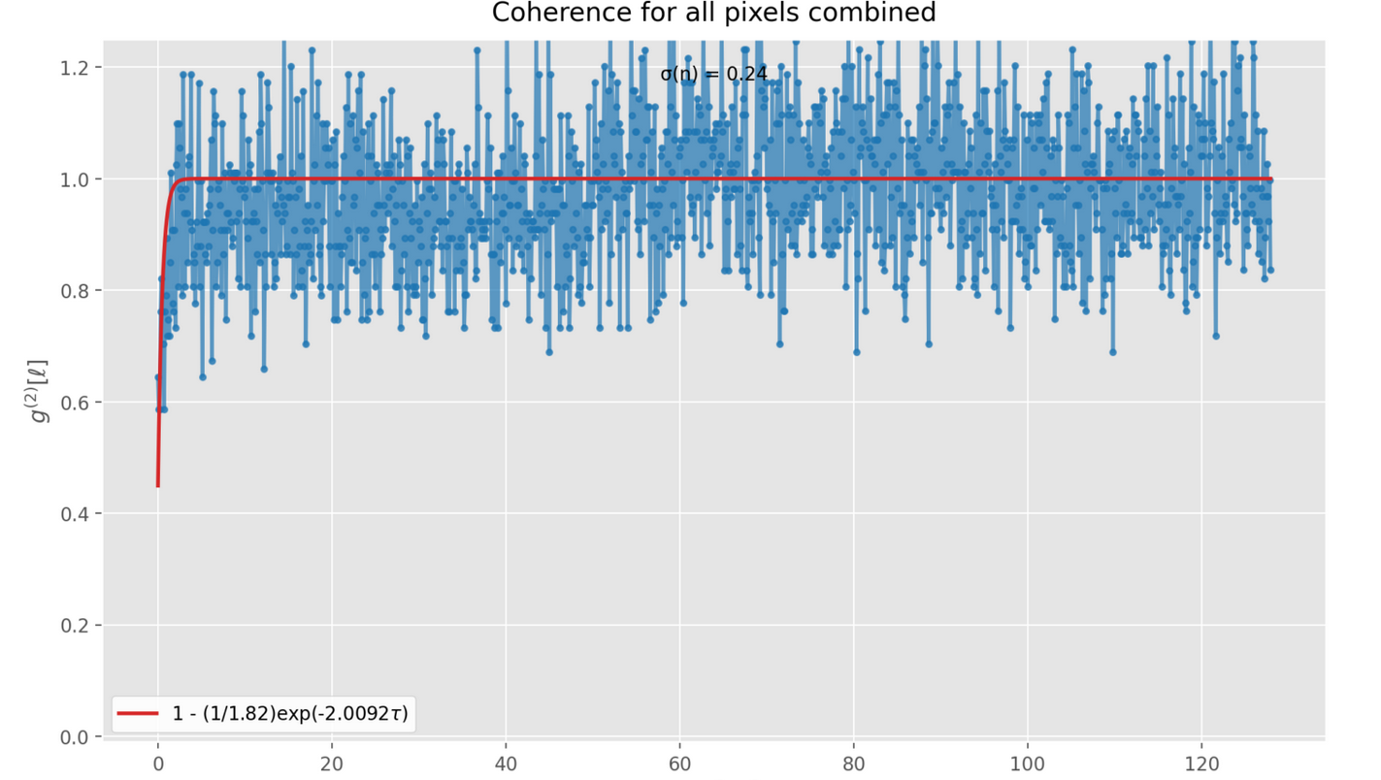
2 emitters
330kw/cm2
Det eff. 1
Dead time 50 ns
2 emitters
330kw/cm2
Det eff. 0.2
Dead time 50 ns

Slide 3
Scanning algorithm
Next slides: no noise factors, no dead time

Slide 4
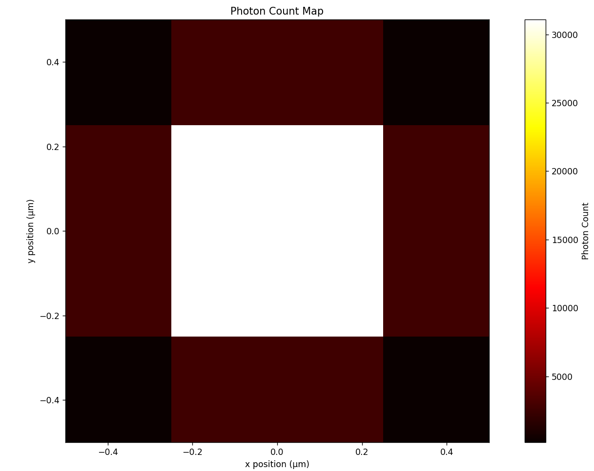





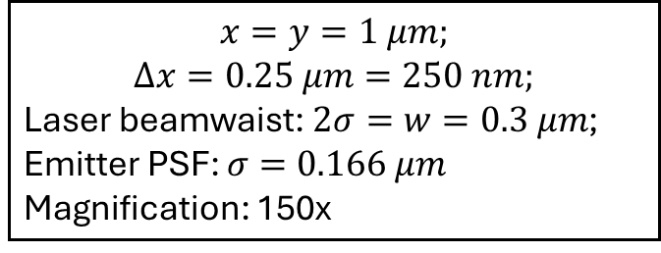




$$x$$
$$u$$
$$i$$
$$i+1$$
$$v$$
$$y$$
Laser gaussian
$$Δx$$
$$x=y=1 μm;$$
$$Δx=0.25 μm=250 nm;$$
Laser beamwaist: $2σ=w=0.3 μm$;
Emitter PSF: $σ=0.166 μm$
Magnification: 150x
Fluorophore PSF
Notes:
Way to large step size

Slide 5
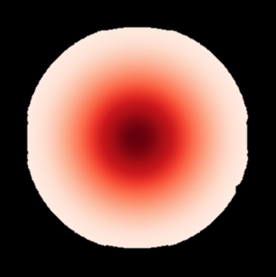
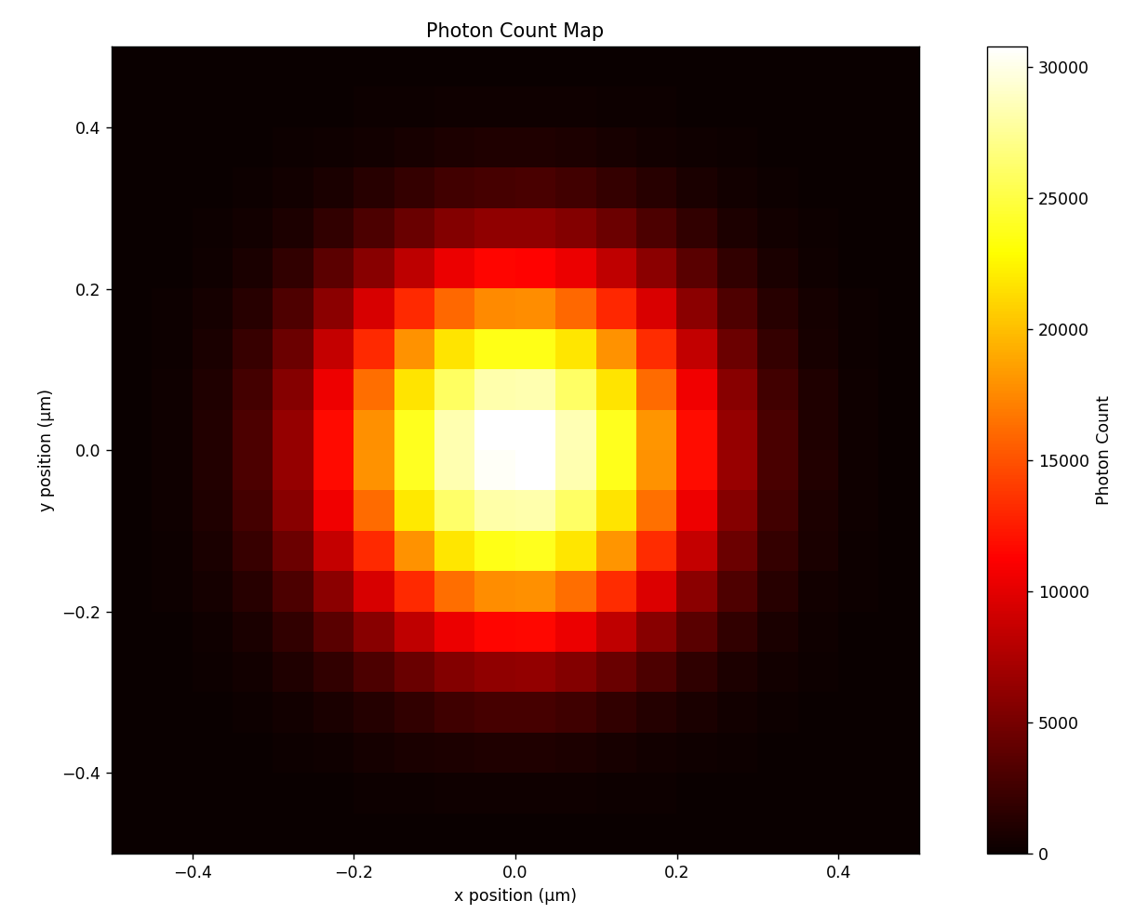






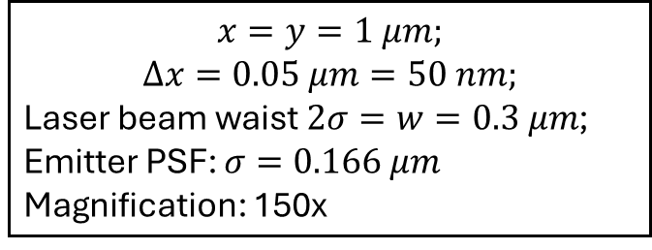
$$x$$
$$u$$
$$i$$
$$i+1$$
$$y$$
$$v$$
Laser gaussian
$$Δx$$
$$x=y=1 μm;$$
$$Δx=0.05 μm=50 nm;$$
Laser beam waist$2σ=w=0.3 μm$;
Emitter PSF: $σ=0.166 μm$
Magnification: 150x
Notes:
Note: the squares are just for indication; in reality, the PSF’s are not bounded by a square, they just overlap and continue ‘infinitely’

Slide 6
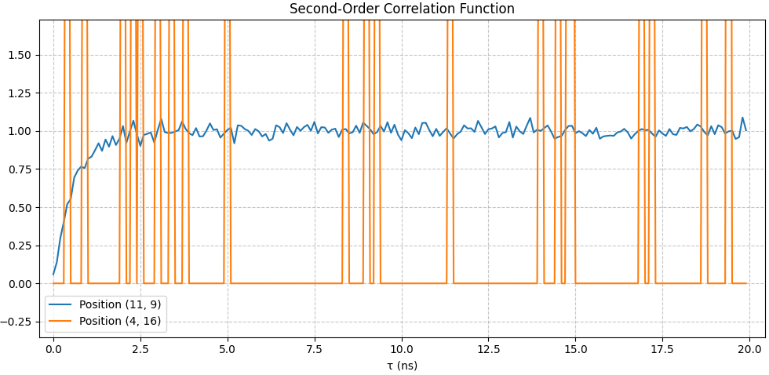
$$x$$
$$u$$
$$i$$
$$i+1$$
$$y$$
$$v$$
Laser gaussian
$$Δx$$
$$x=y=1 μm;$$
$$Δx=0.05 μm=50 nm;$$
Laser beam waist$2σ=w=0.3 μm$;
Emitter PSF: $σ=0.166 μm$
Magnification: 150x
Notes:
Note: the squares are just for indication; in reality, the PSF’s are not bounded by a square, they just overlap and continue ‘infinitely’

Slide 7
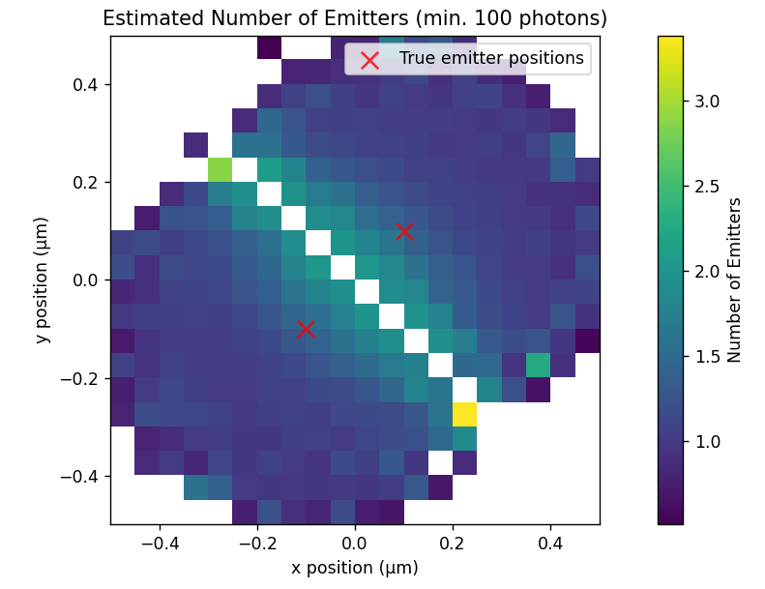
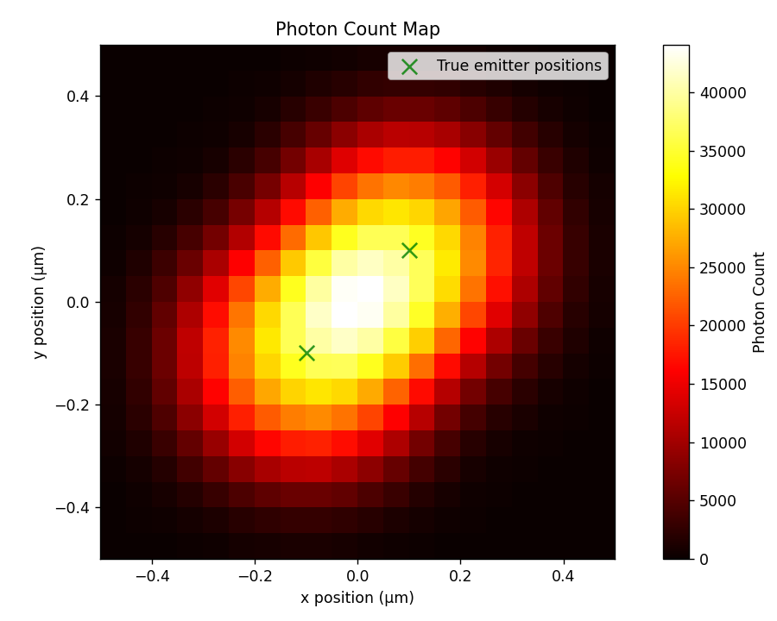
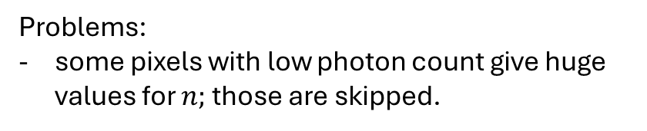
Problems:
some pixels with low photon count give huge values for $n;$those are skipped.

Slide 8
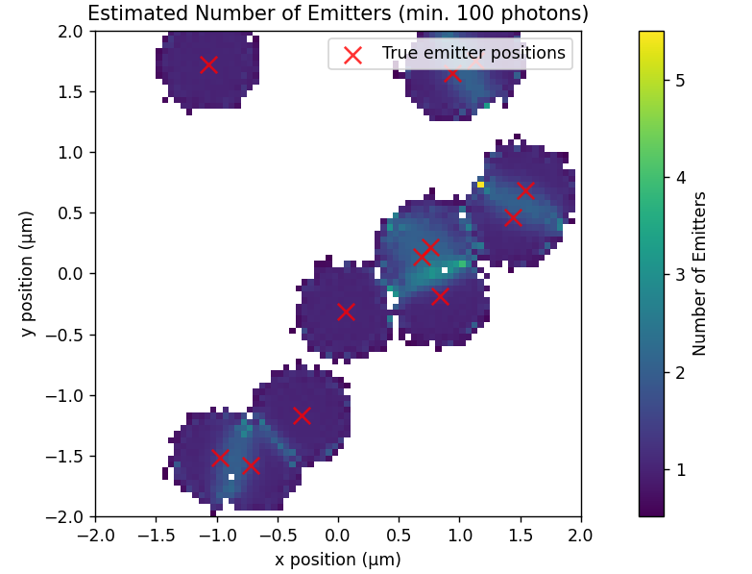
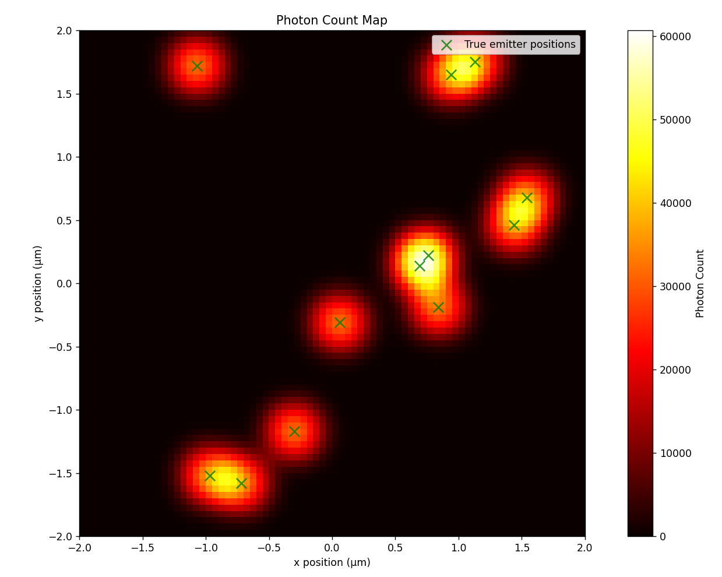

Slide 9
Given the 3d ‘landscape’ of estimated emitters and that of intensity, what are the most likely locations for emitters.
Max likelihood estimation description
ISM? QISM?

Slide 10
